Slide 1
Smart Timetable & Classroom Allocation System
THE SMART TIMETABLE & CLASSROOM ALLOCATION SYSTEM IS DESIGNED TO AUTOMATE THE PROCESS OF TIMETABLE CREATION AND CLASSROOM SCHEDULING IN EDUCATIONAL INSTITUTIONS
PURPOSE
REDUCE MANUAL SCHEDULING WORK
AVOID TIMETABLE CONFLICTS
IMPROVE CLASSROOM UTILIZATION
MAKE SCHEDULING FASTER AND MORE EFFICIENT
PRESENTED BY : RAVINA RANA & AASHISH VISHWAKARMA
COURSE : FYBSCIT-A
COLLEGE : THAKUR RAMNARAYAN COLLEGE OF ARTS AND
COMMERCE

Slide 2
Project Overview & Problem Statement
Project overview
Web-based academic scheduling system
Automates timetable generation
Manages classroom allocation
Reduces manual scheduling work
Problem statement
Time-consuming manual timetables
Teacher scheduling conflicts
Classroom allocation issues
Overlapping student lectures
Inefficient room utilization

Slide 3
Objectives & key features
Objectives
Automate timetable generation
Prevent scheduling conflicts
Manage classroom availability
Check student capacity
Improve resources utilization
Key features
Add class details
Automatic timetable generation
Teacher availability checking
Classroom allocation
Batch conflicts detection
Capacity validation
Dashboard and statistics
Classroom utilization calculation

Slide 4
Technologies & Tools used
Programming languages
Technology Purpose
HTML5 Website structure
CSS3 Styling and Layout
JavaScript Application Logic
Technicals Implementation
Frontend-based architecture
JavaScript arrays and objects
Set data structure for conflict checking
Rule-based scheduling algorithm
Development Tools
Visual Studio Code – code editor
Google Chrome – Testing
Live Server – Local preview

Slide 5
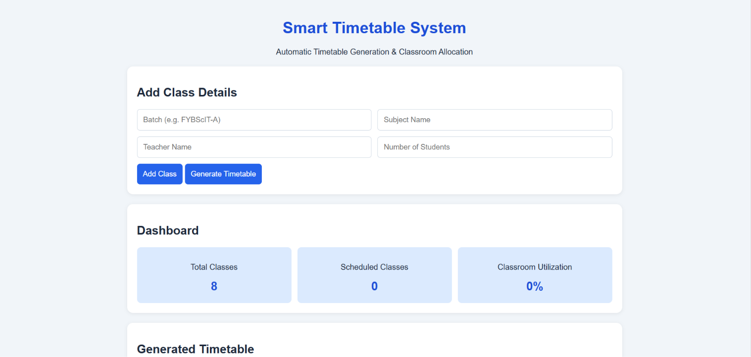
Working process & system output
System workflow
Enter teacher , subject and batch details
Validate class information
Check classroom capacity
Find available time slots
Allocate classrooms
Generate timetable
System output
Classroom allocation details
Scheduled class count
Total class count
Utilization percentage

Slide 6
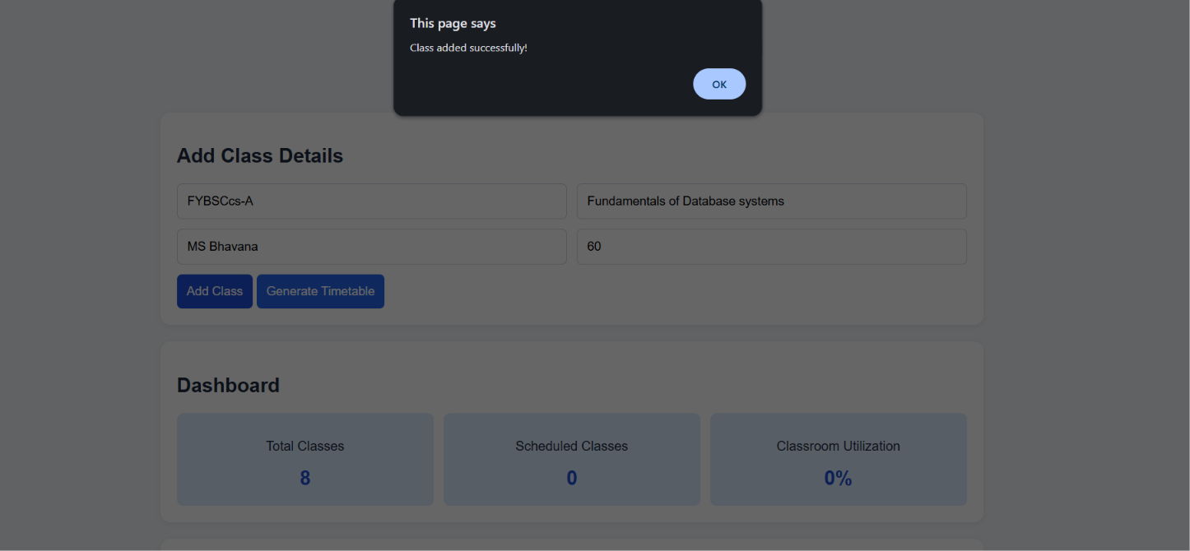
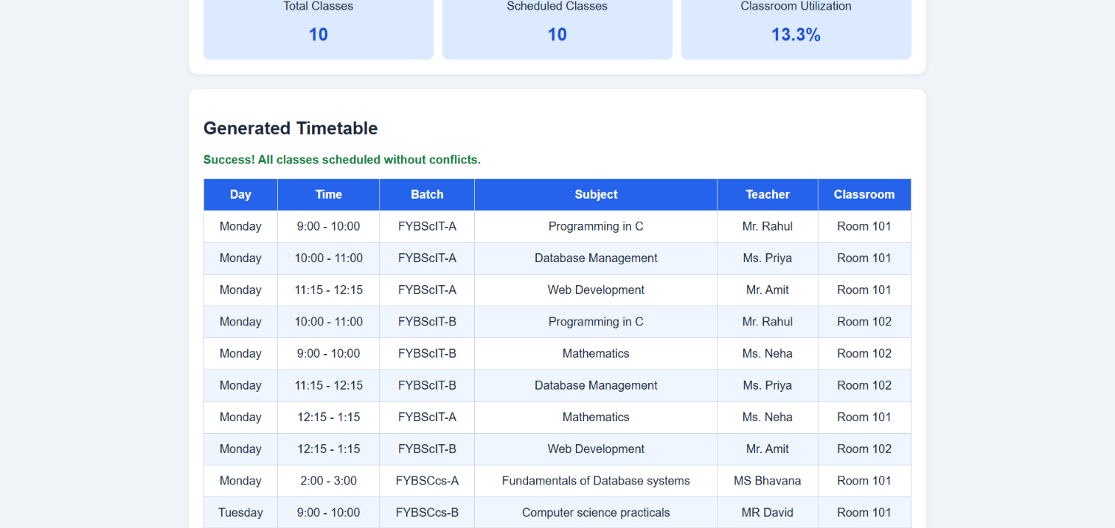
Samples of our project

Slide 7
Unique Features , Benefits & Future Scope
What makes it special?
Automated scheduling
Multiple conflicts checks
Capacity-based allocation
Resources utilization tracking
Simple user-friendly interface
Advantage
Saves time
Reduces scheduling errors
Simplifies classroom management
Improves scheduling efficiency

Slide 8
THANKYOU SO MUCH
PRESENTED BY RAVINA RANA & AASHISH VISHWAKARMA
COURSE : FYBSCIT-A

